Slide 1
Elementary
A C++ Library for Building Intelligent Games
By: Erin McNulty, Shruti Verma, Jennifer Wang

Slide 2
Outline
Shruti - Opening slide
Shruti - The problem
Jennifer - Minimax algo
Jennifer - Core folder design
Jennifer - Minimax solver
Erin - Player
Erin - Gamestate
Erin - Other folders
Shruti - A look into evalHeuristics() and getNextState() for our three classes
Demo of 3 games
Jennifer - tic tac toe
Shruti - Isolation
Erin - checkers
Jennifer - Performance tests
Erin - Looking ahead w/ C++ features
Erin - Closing

Slide 3

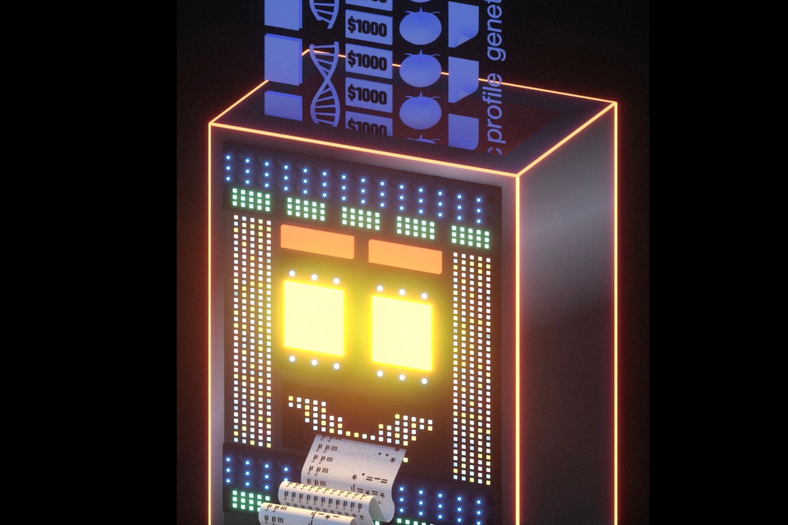
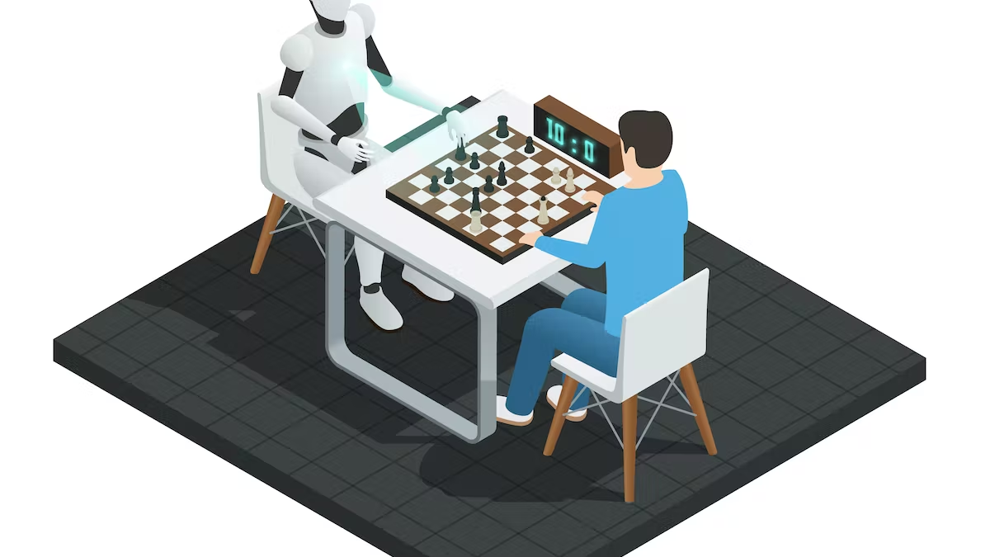
“Elementary, my dear Watson”
Notes:
Tell people why they should bother listen to you
– What useful and interesting stuff will they learn?
– A picture (or two) would be good
• Think outside the box (“if in doubt use a Martian”)

Slide 4
The Idea

Slide 5
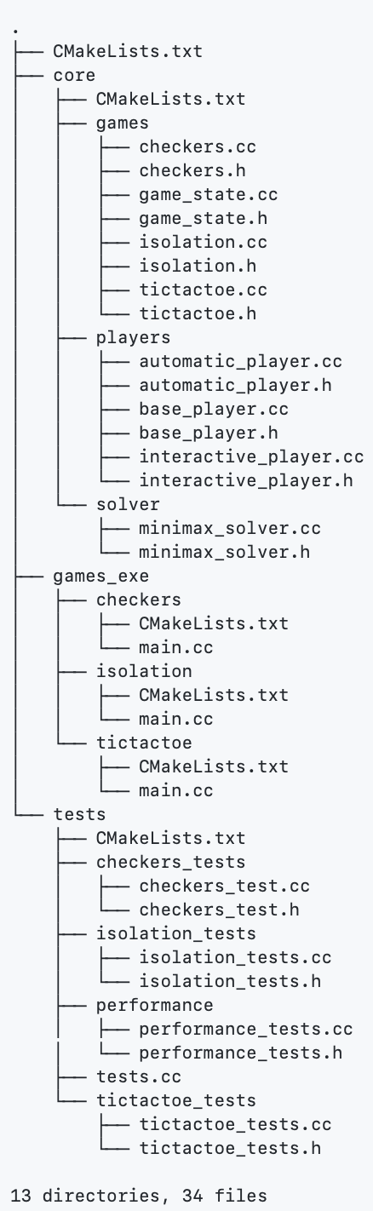
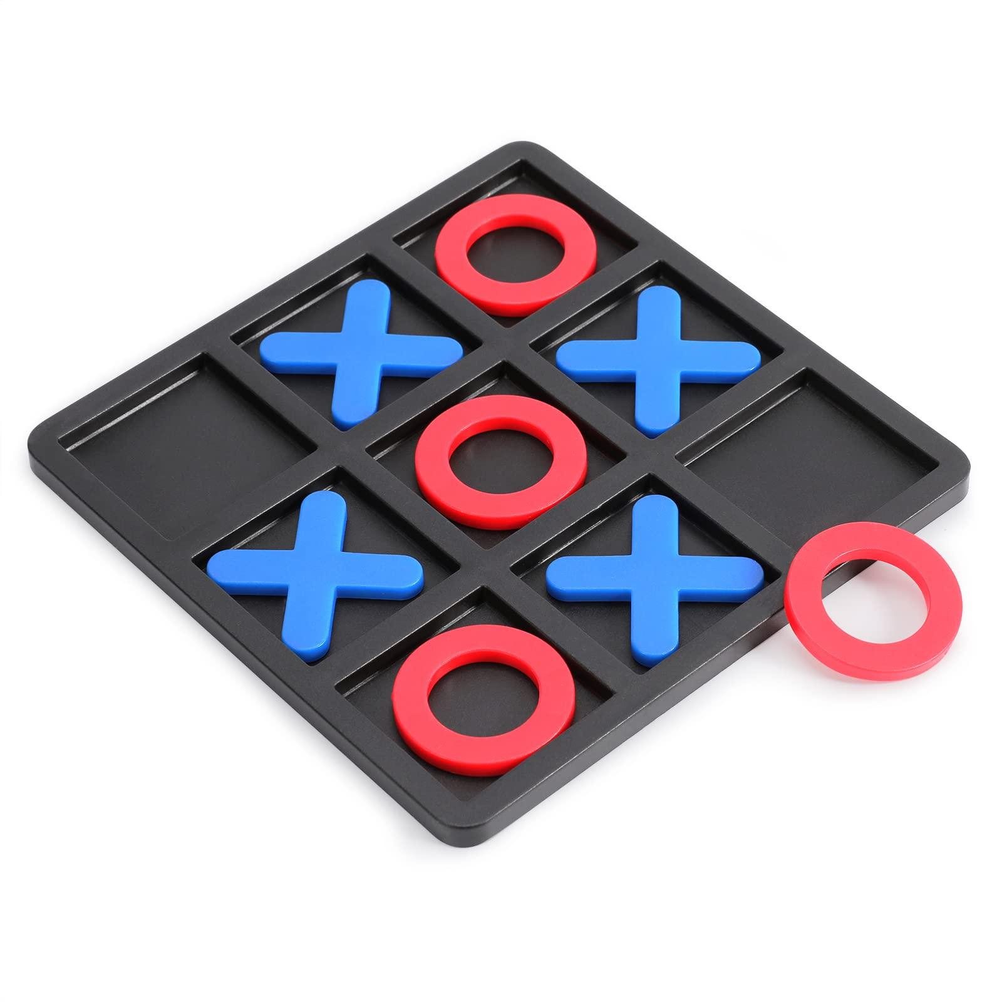
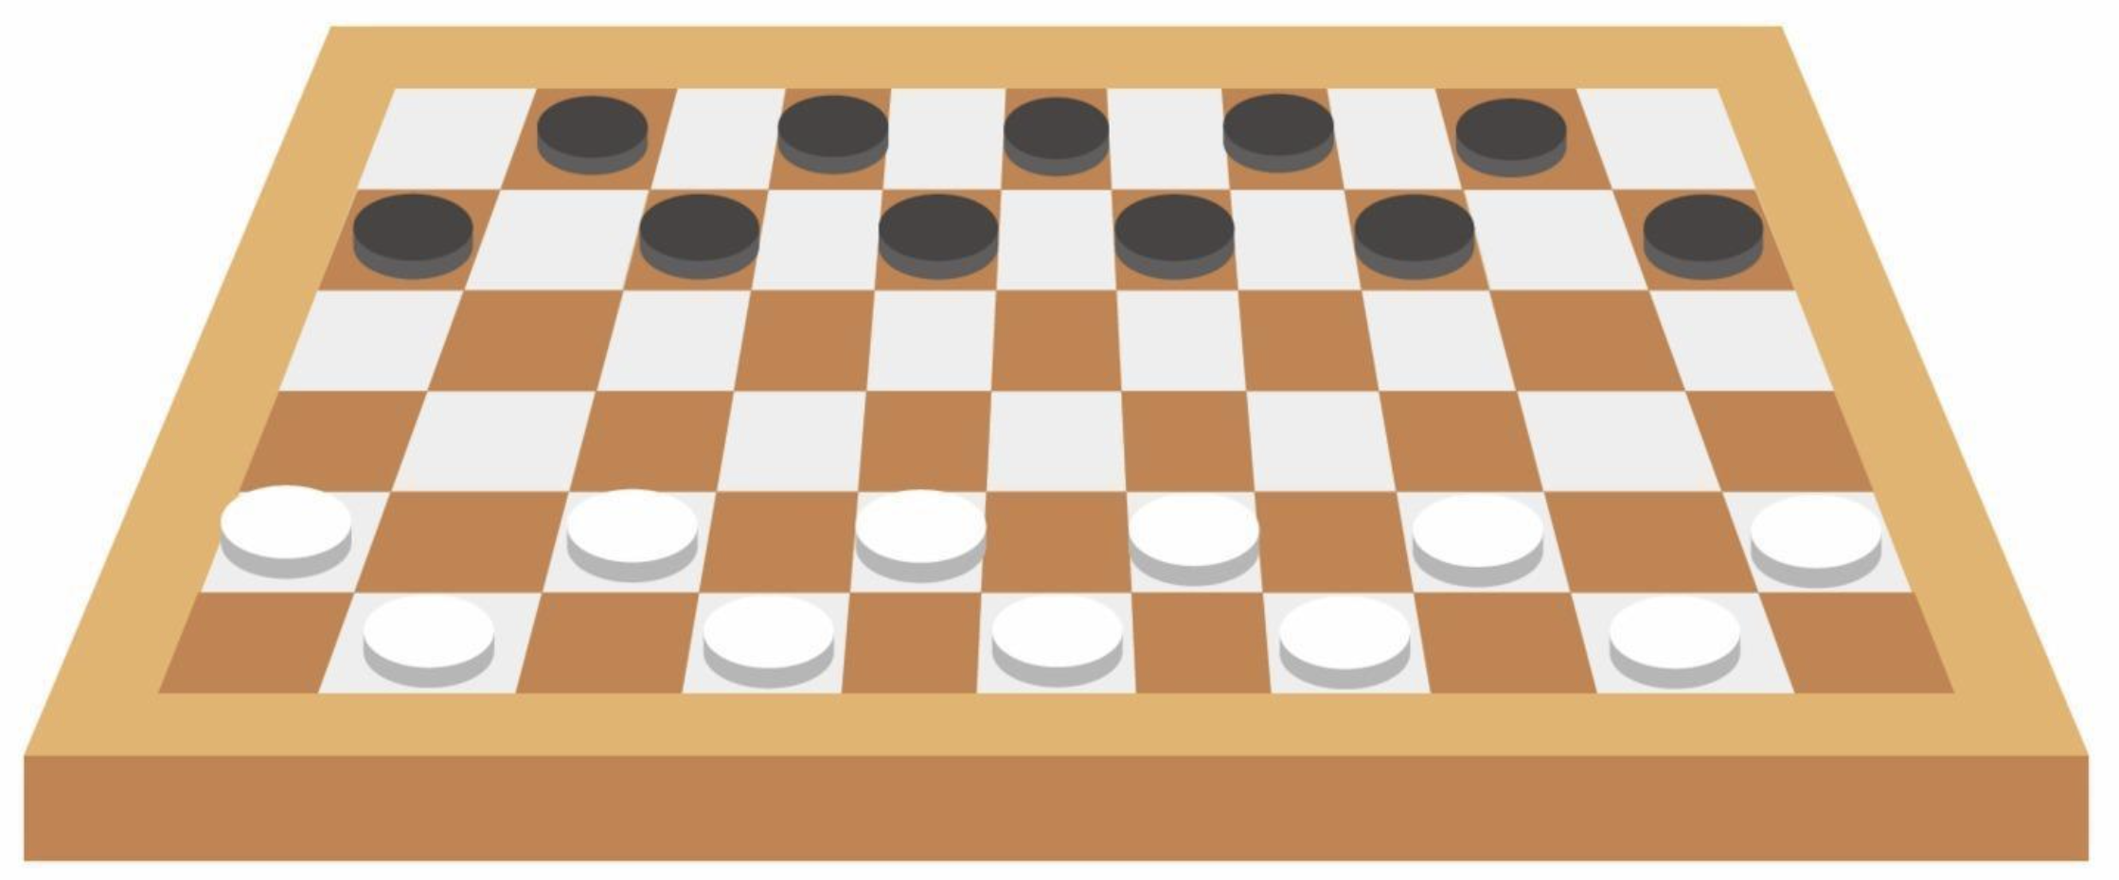
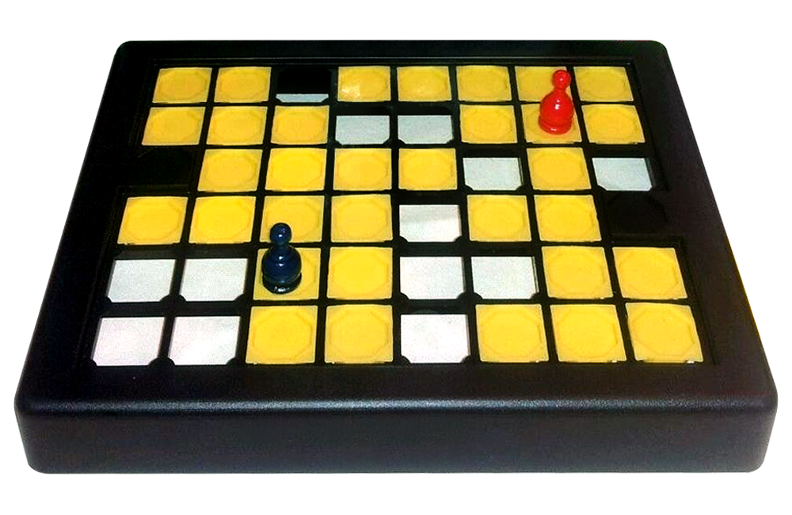
Elementary
WHAT? An intelligent framework for specifying interactive games
HOW? Generic minimax solver, players, and many other layers of hierarchy
WHO? Developers of all background
WHO? Users who just want to have fun playing games!

Slide 6
Technical Background
The minimax algorithm
Notes:
=> show minimax algoritm

Slide 7
Minimax Intuition
X | X
O | X
O |  | O
Game Configuration:
X | X | X
O | X
O |  | O
X | X
O | X | X
O |  | O
X | X
O | X
O | X | O
X’s turn
1
X | X | O
O | X | X
O |  | O
X | X
O | X | X
O | O | O
…
O’s turn
-1

Slide 8
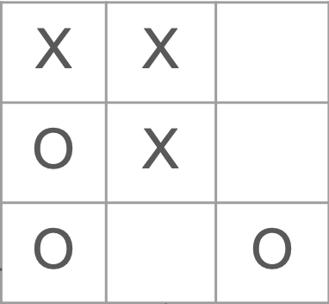
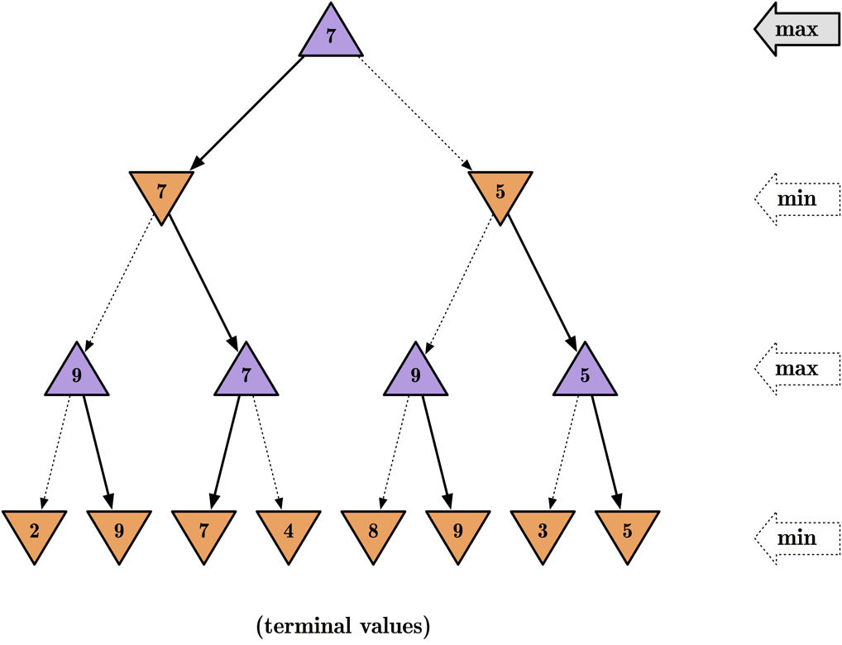
Minimax Algorithm
X’s turn
What is the best move for me at the current state?
Intelligent Adversarial Search
“A fancy DFS”
O’s turn
X’s turn
”Game over”

Slide 9
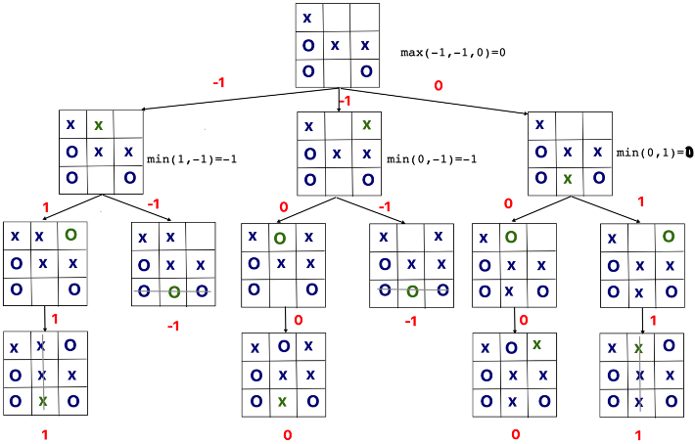


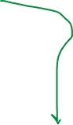
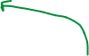


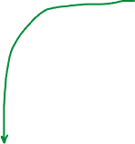



Basic Minimax: Tic-tac-toe
“Fancy” DFS

Slide 10
Basic Minimax: Tic-tac-toe
At each leaf node:
+1 if “win”
0 if “draw”
-1 if “lose”

Slide 11
Basic Minimax: Tic-tac-toe
At each leaf node:
+1 if “win”
0 if “draw”
-1 if “lose”

Slide 12
Basic Minimax: Tic-tac-toe
“Fancy” DFS
Need to iterate through the entire tree
Not practical in practice!

Slide 13
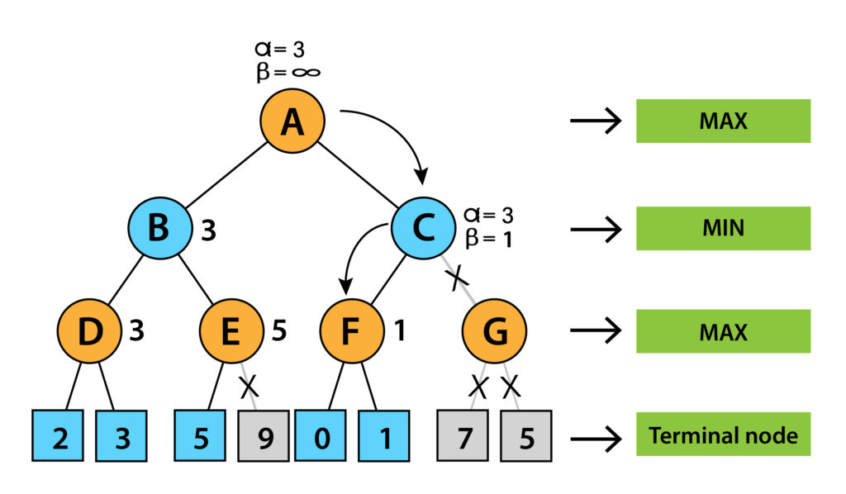
Optimization: α-β Pruning
Goal: Decrease the search space
Strategy: Cut off portions of the search tree which you know will not yield a better value than you have already found
Pass alpha & beta down:
Alpha: The best (highest) value that a maximizer can currently guarantee.
Beta: The best (lowest) value that a minimizer can currently guarantee.

Slide 14
Design Approach
Notes:
=> design diagram

Slide 15
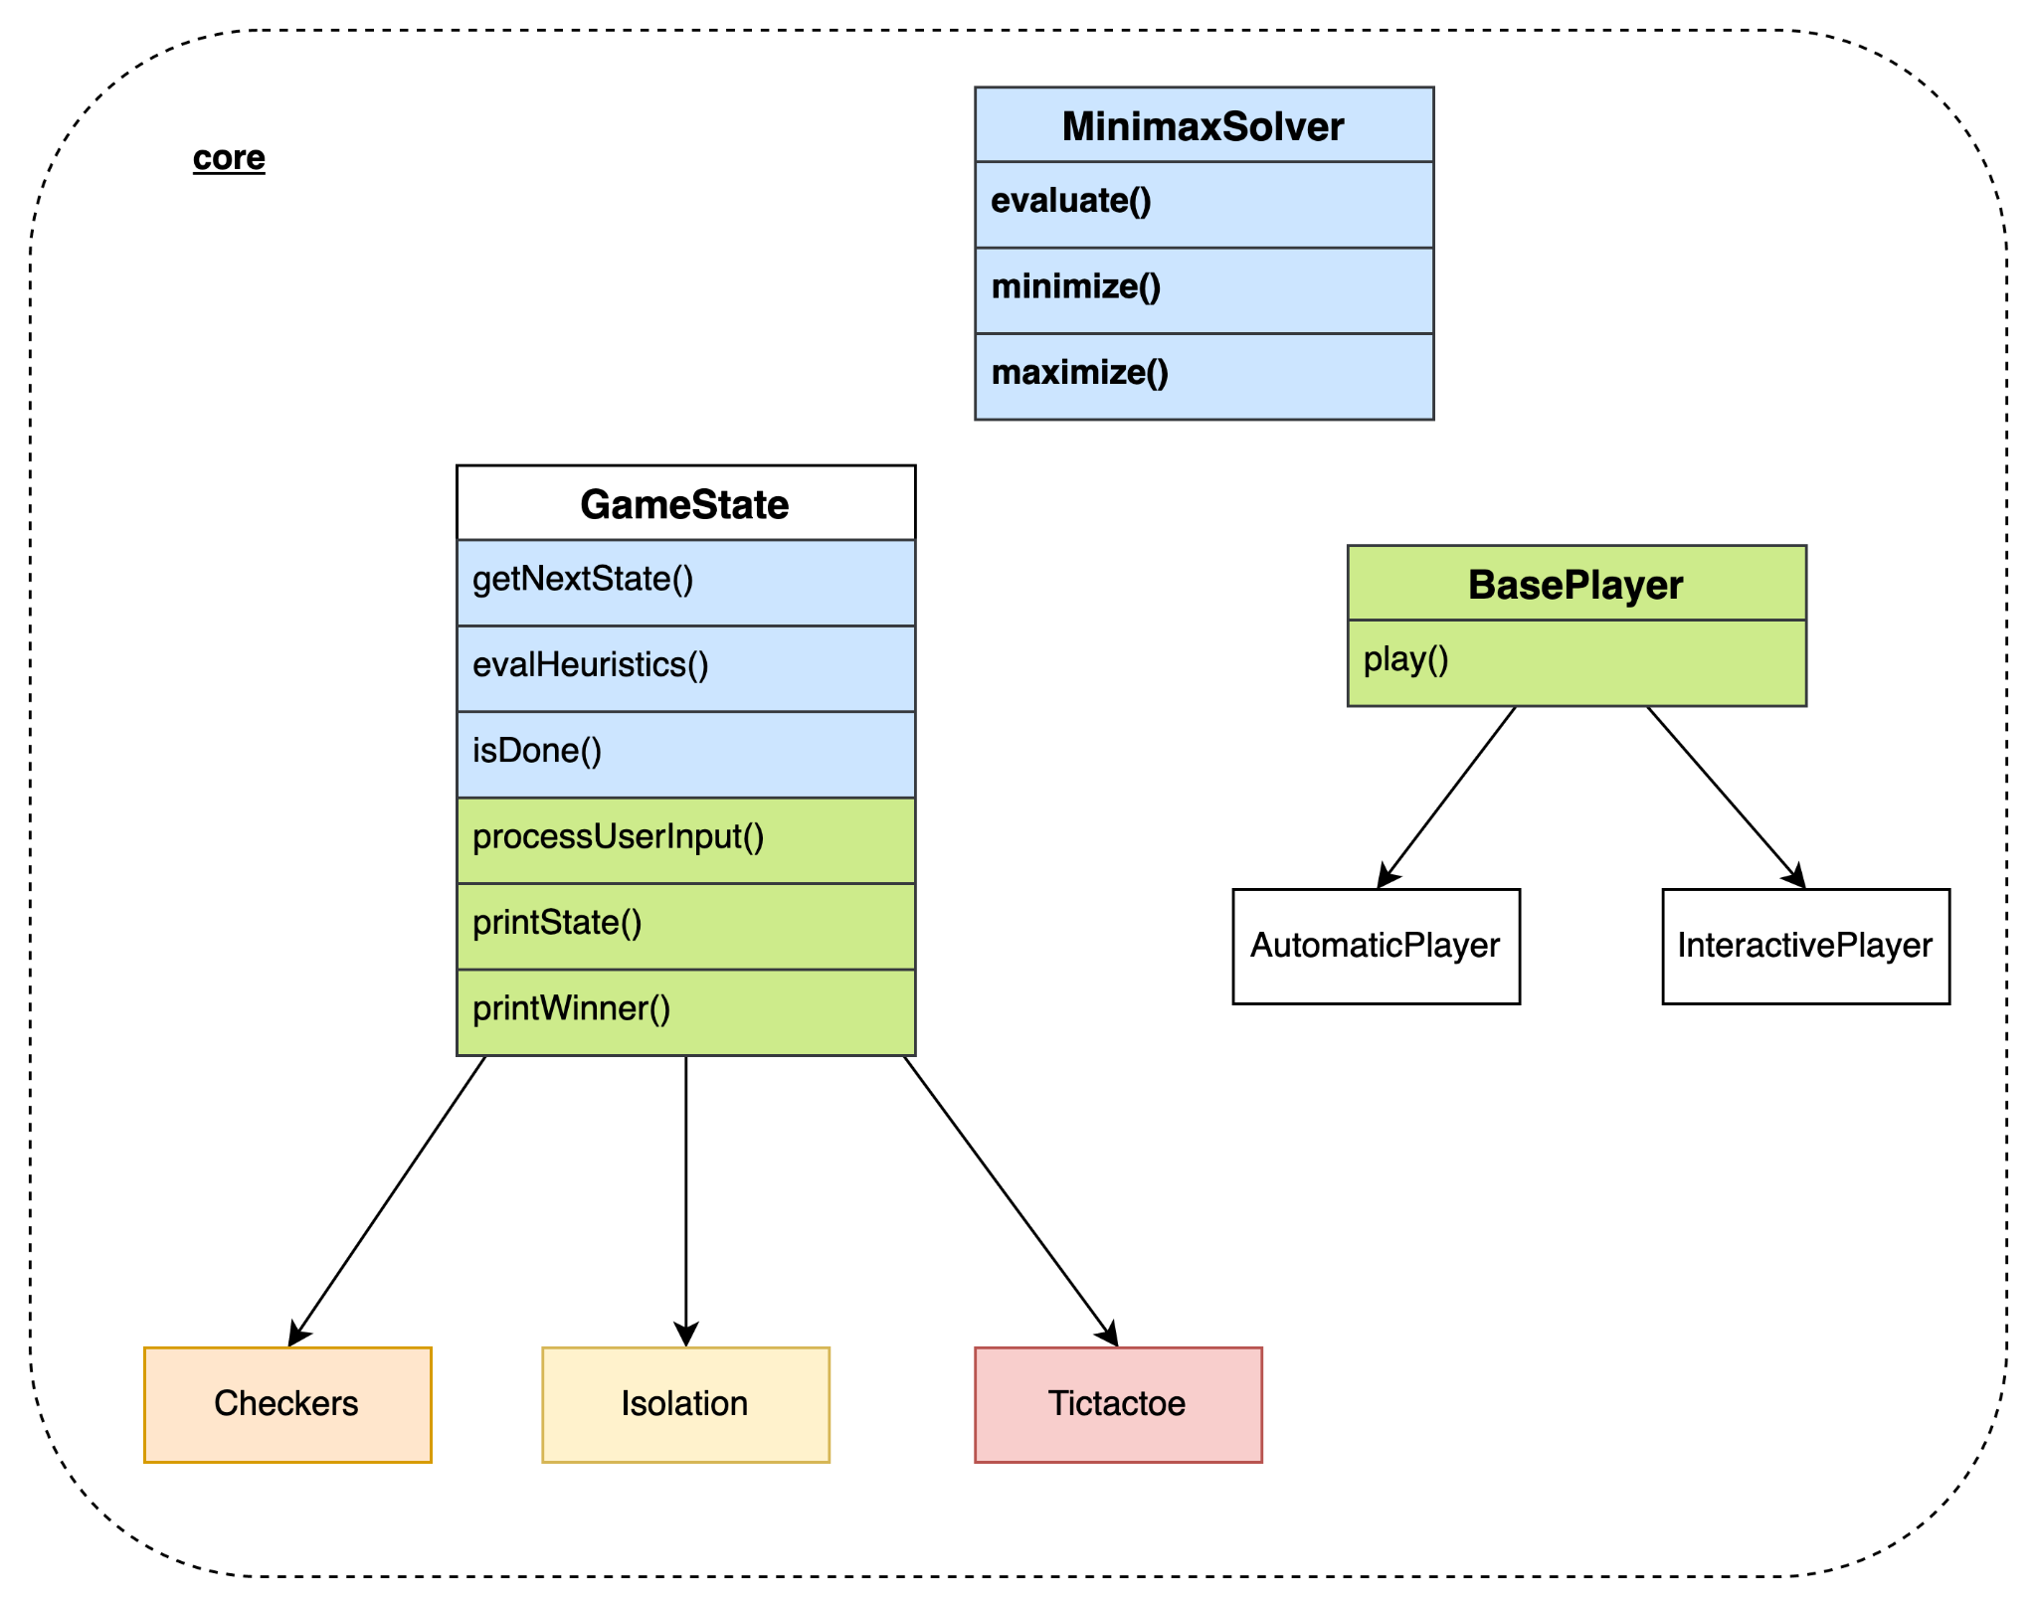
Design Overview

Slide 16
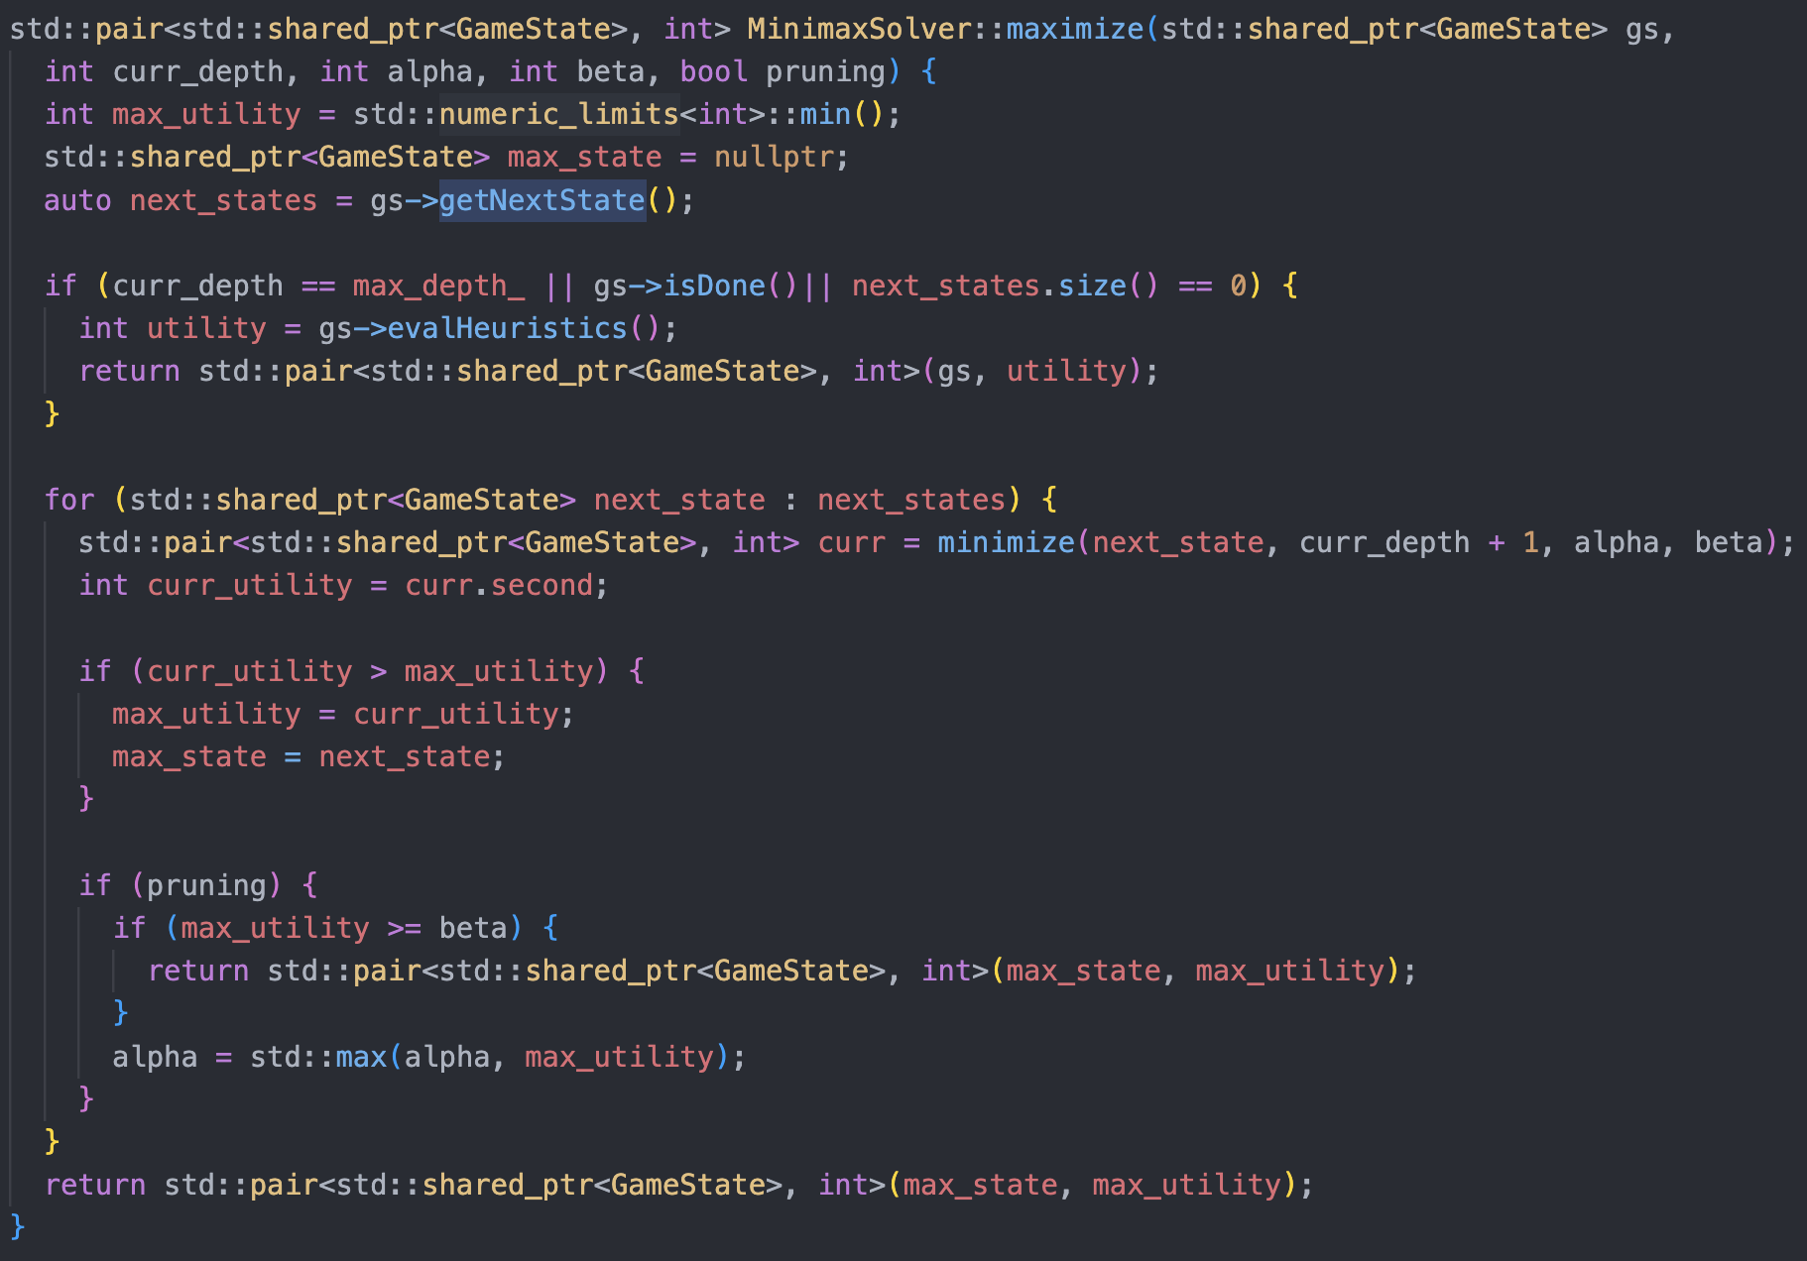
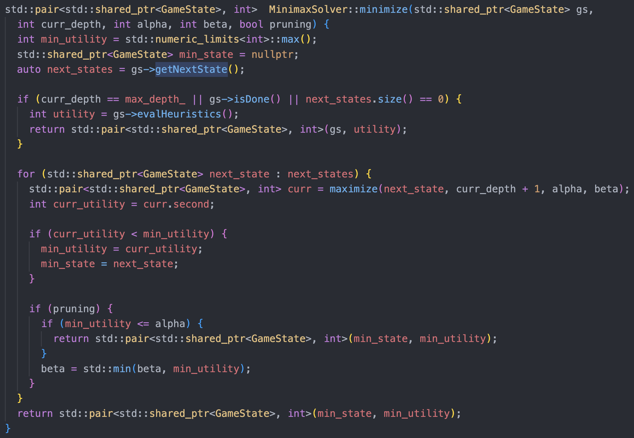
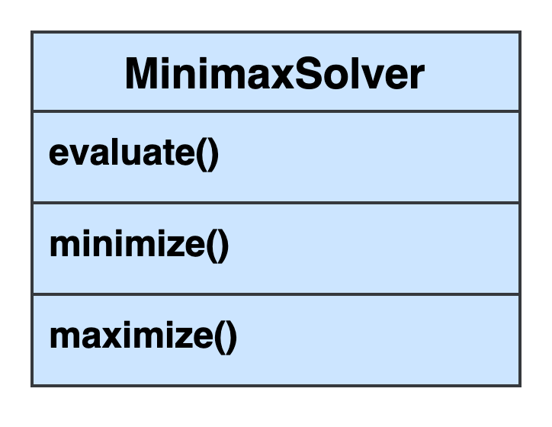
The Minimax Solver
Generically implements the minimax algorithm, calling functions of GameState

Slide 17
Minimize()
Evaluate via heuristics if max_depth is reached
Iterate through all child states and find the state with the minimum utility
Use alpha-beta pruning for optimization
Notes:
Source: https://towardsdatascience.com/understanding-the-minimax-algorithm-726582e4f2c6

Slide 18
Maximize()
Evaluate via heuristics if max_depth is reached
Iterate through all child states and find the state with the maximum utility
Use alpha-beta pruning for optimization
Notes:
Source: https://towardsdatascience.com/understanding-the-minimax-algorithm-726582e4f2c6

Slide 19
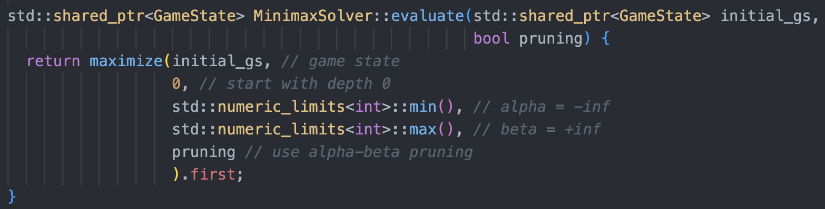
evaluate()

Slide 20
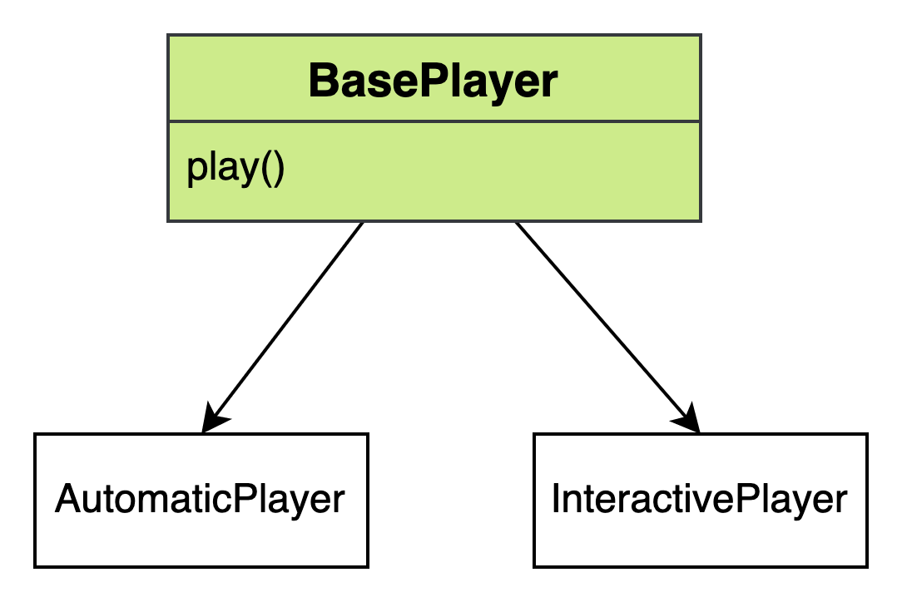
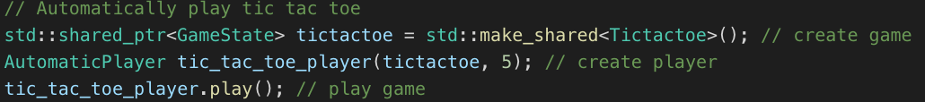
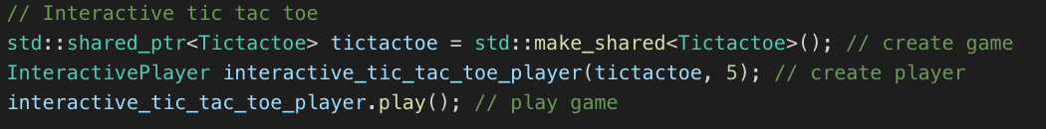
The Players
Automatic: computers play against each other
Interactive: human vs. computer
Do the nitty gritty work of leveraging the minimax solver: simulation, user-input processing, best-move calculation, score-keeping, …
All the user has to do is pass their game to a player and call play()!

Slide 21
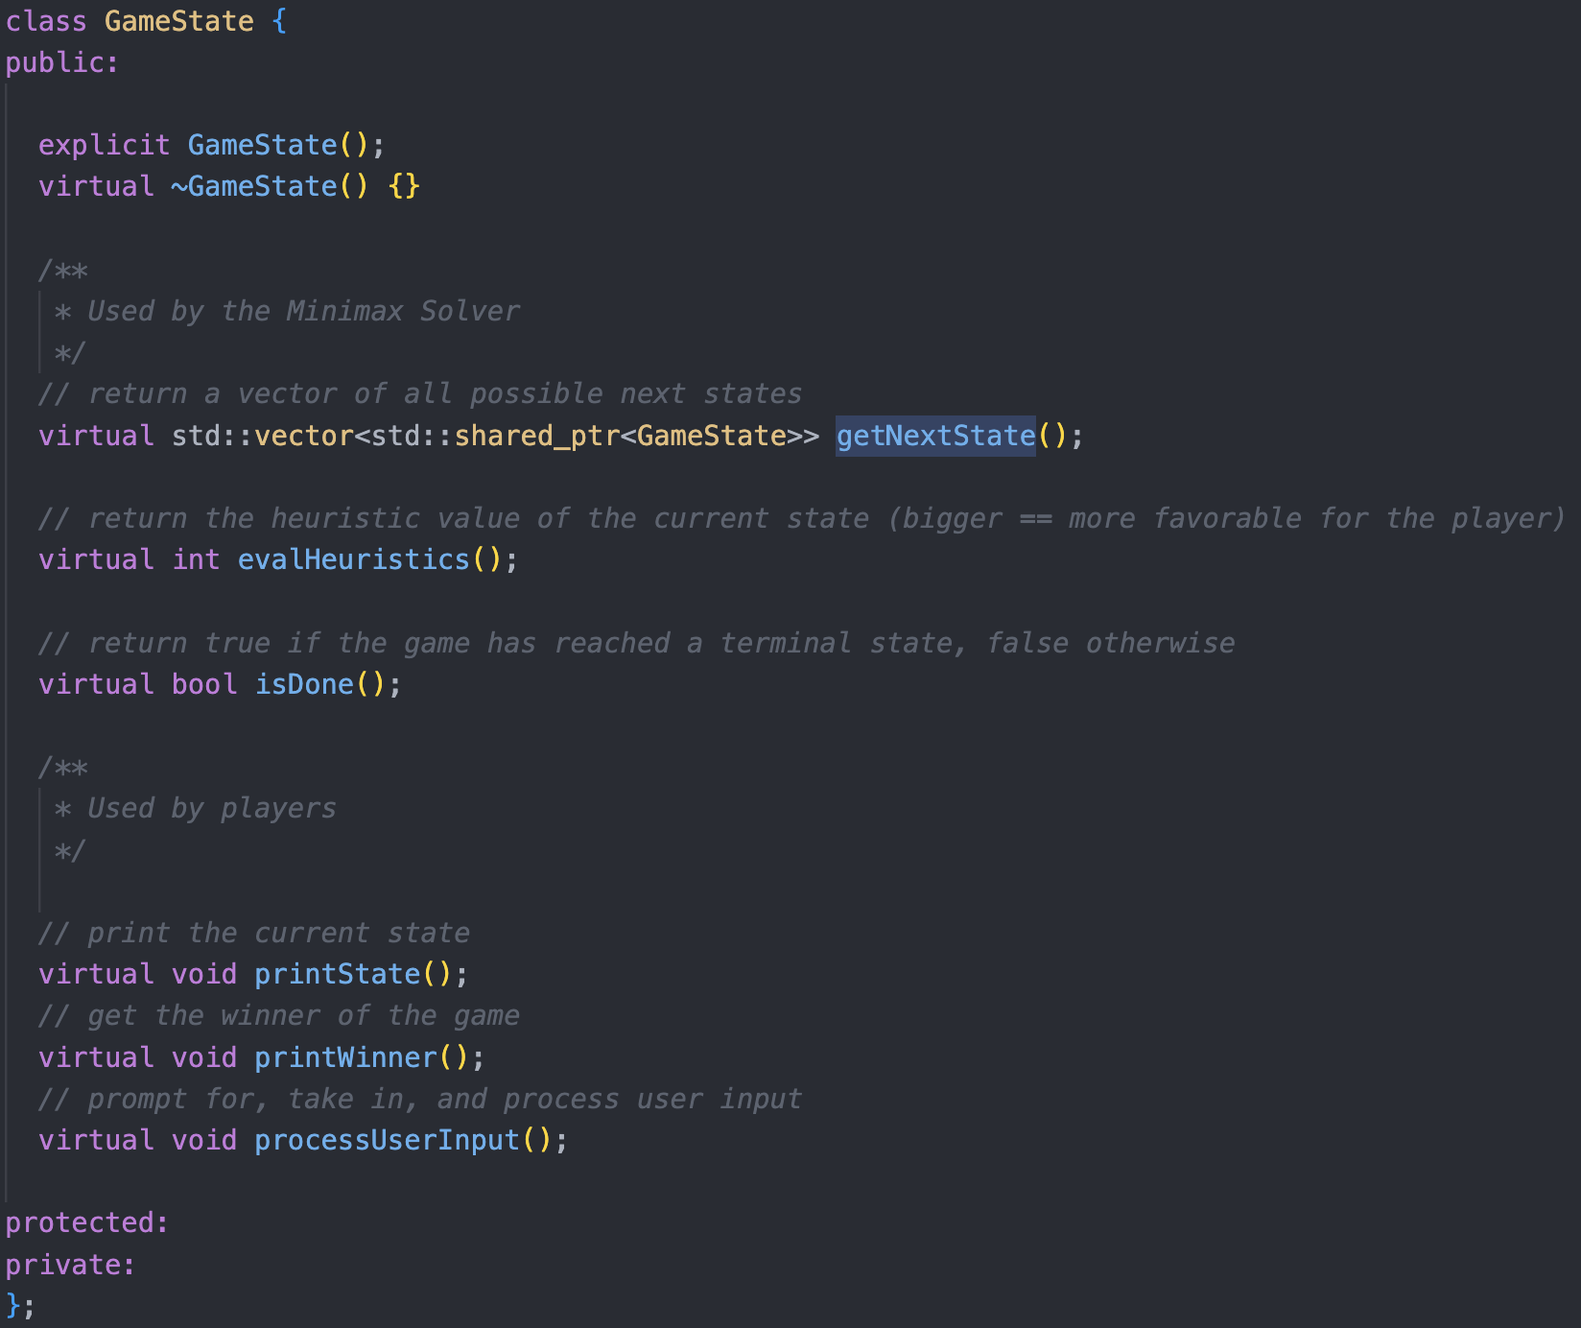
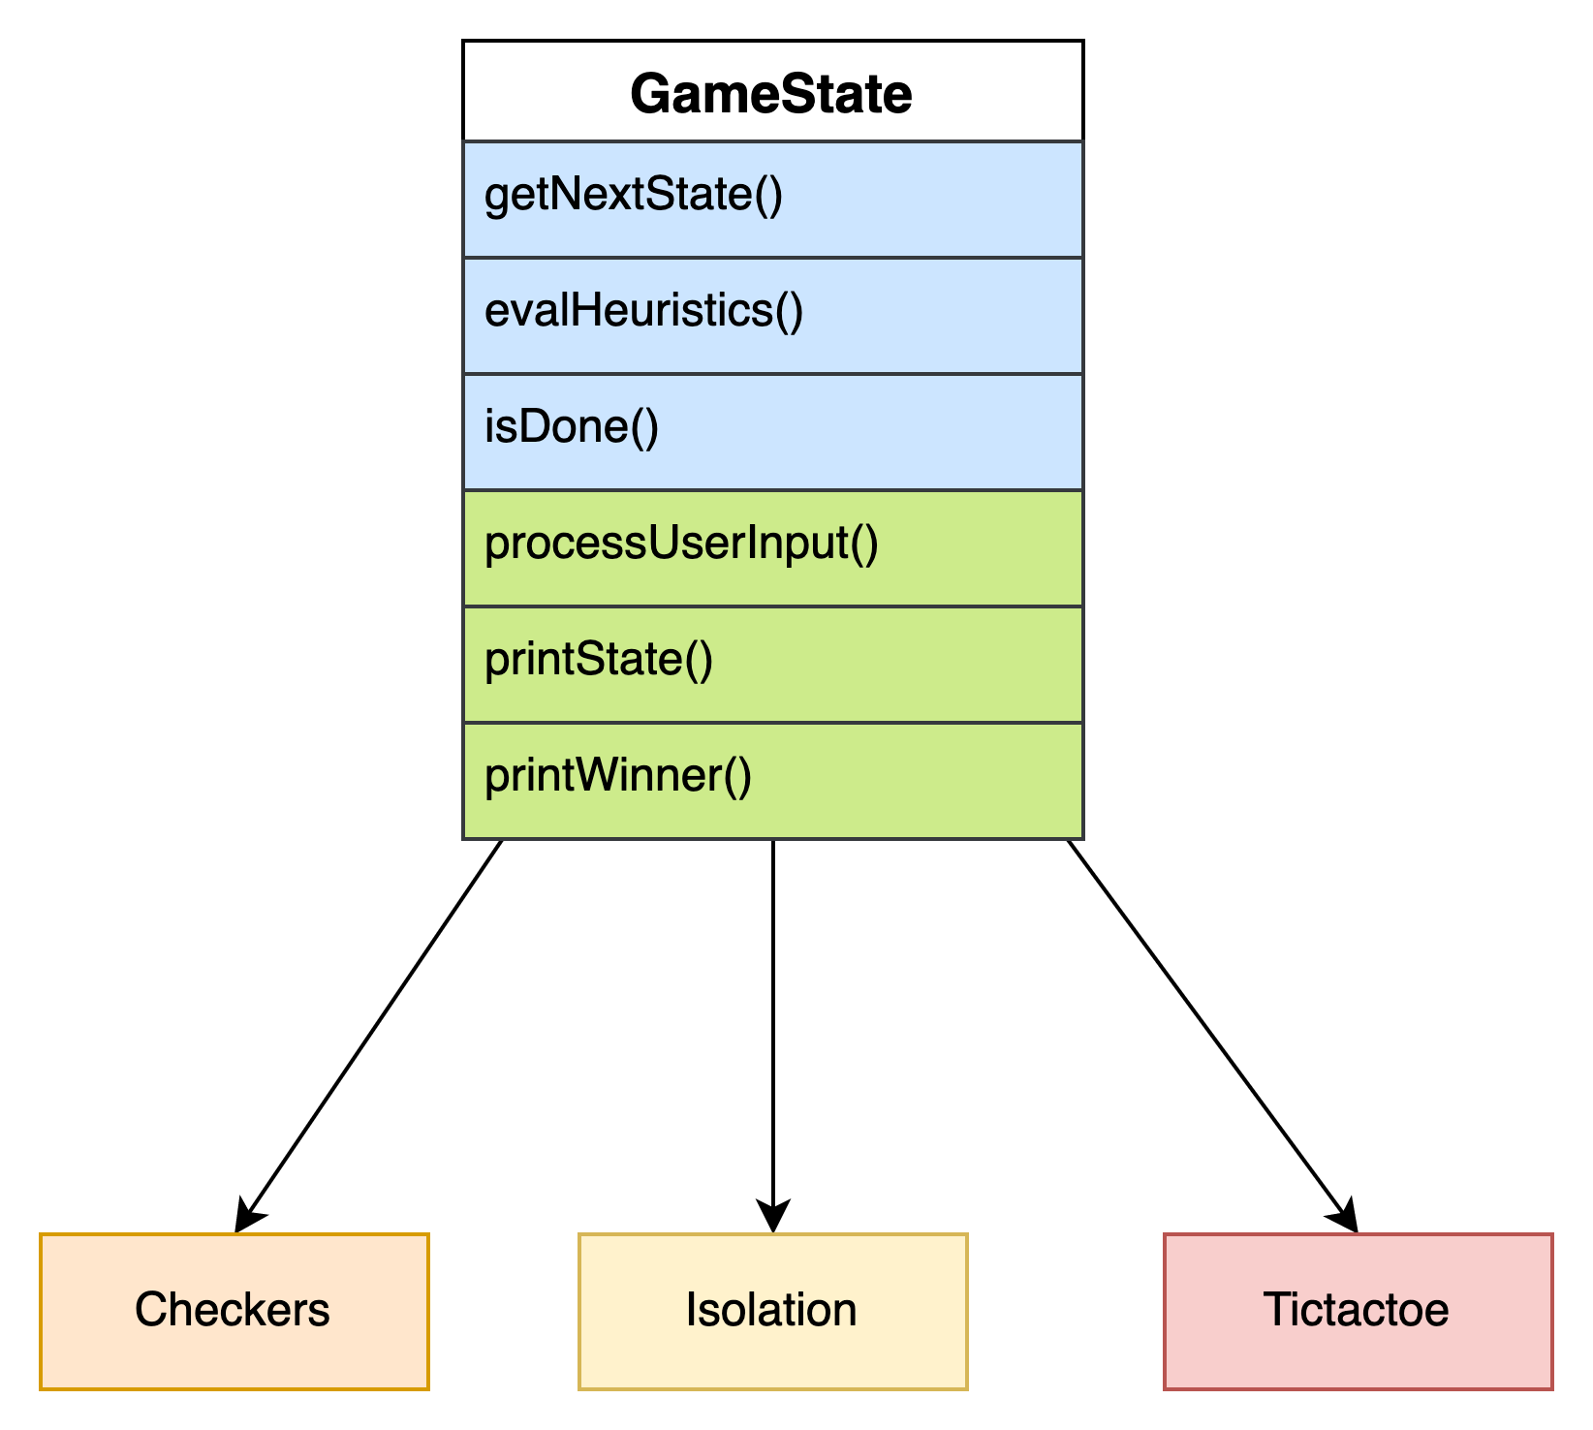
The GameState Class
Composed of a series of virtual functions that are called by the minimax algorithm and the players

Slide 22
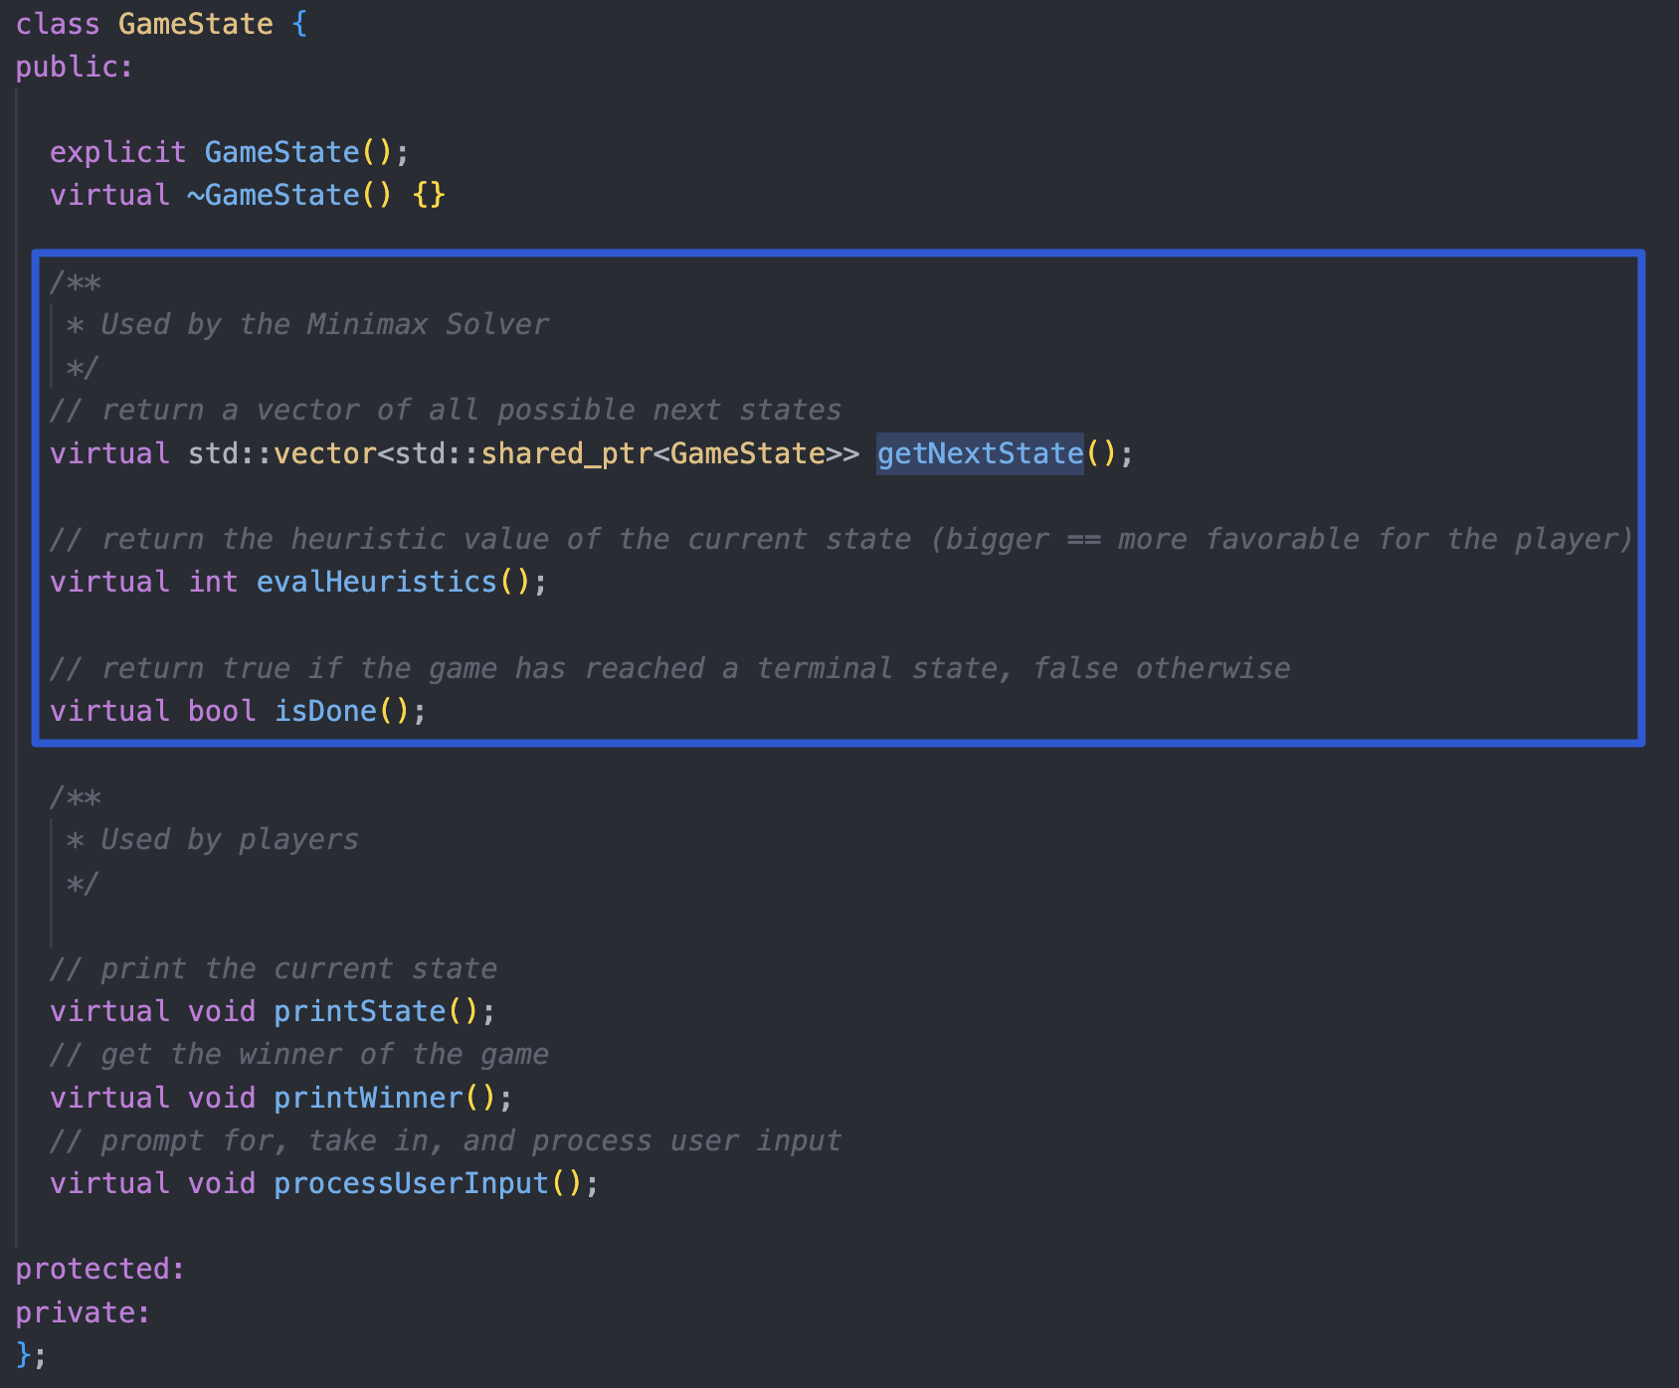
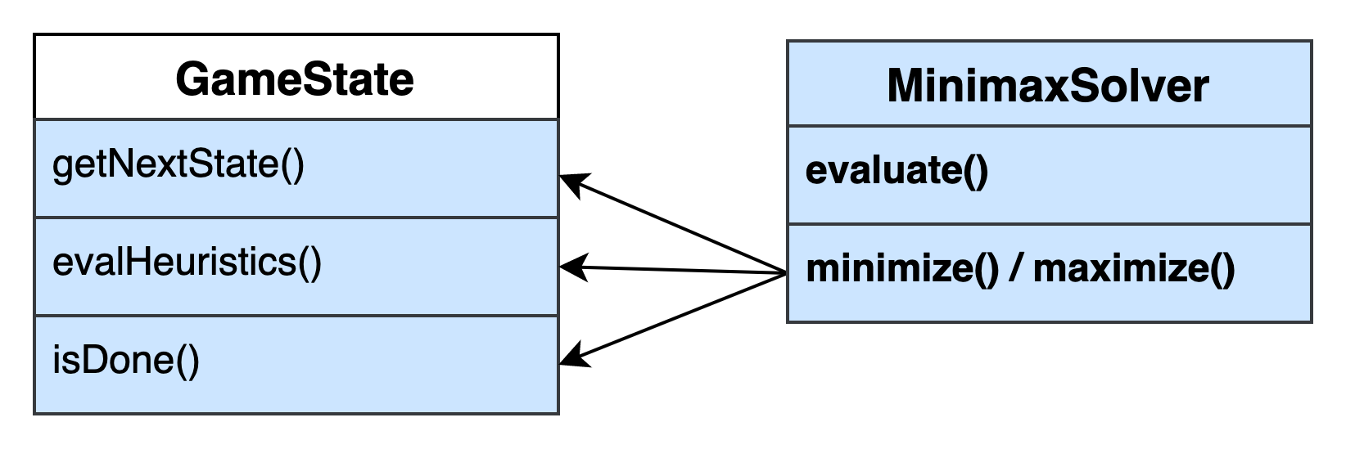
GameState & Minimax
Composed of a series of virtual functions that are called by the minimax algorithm and the players

Slide 23
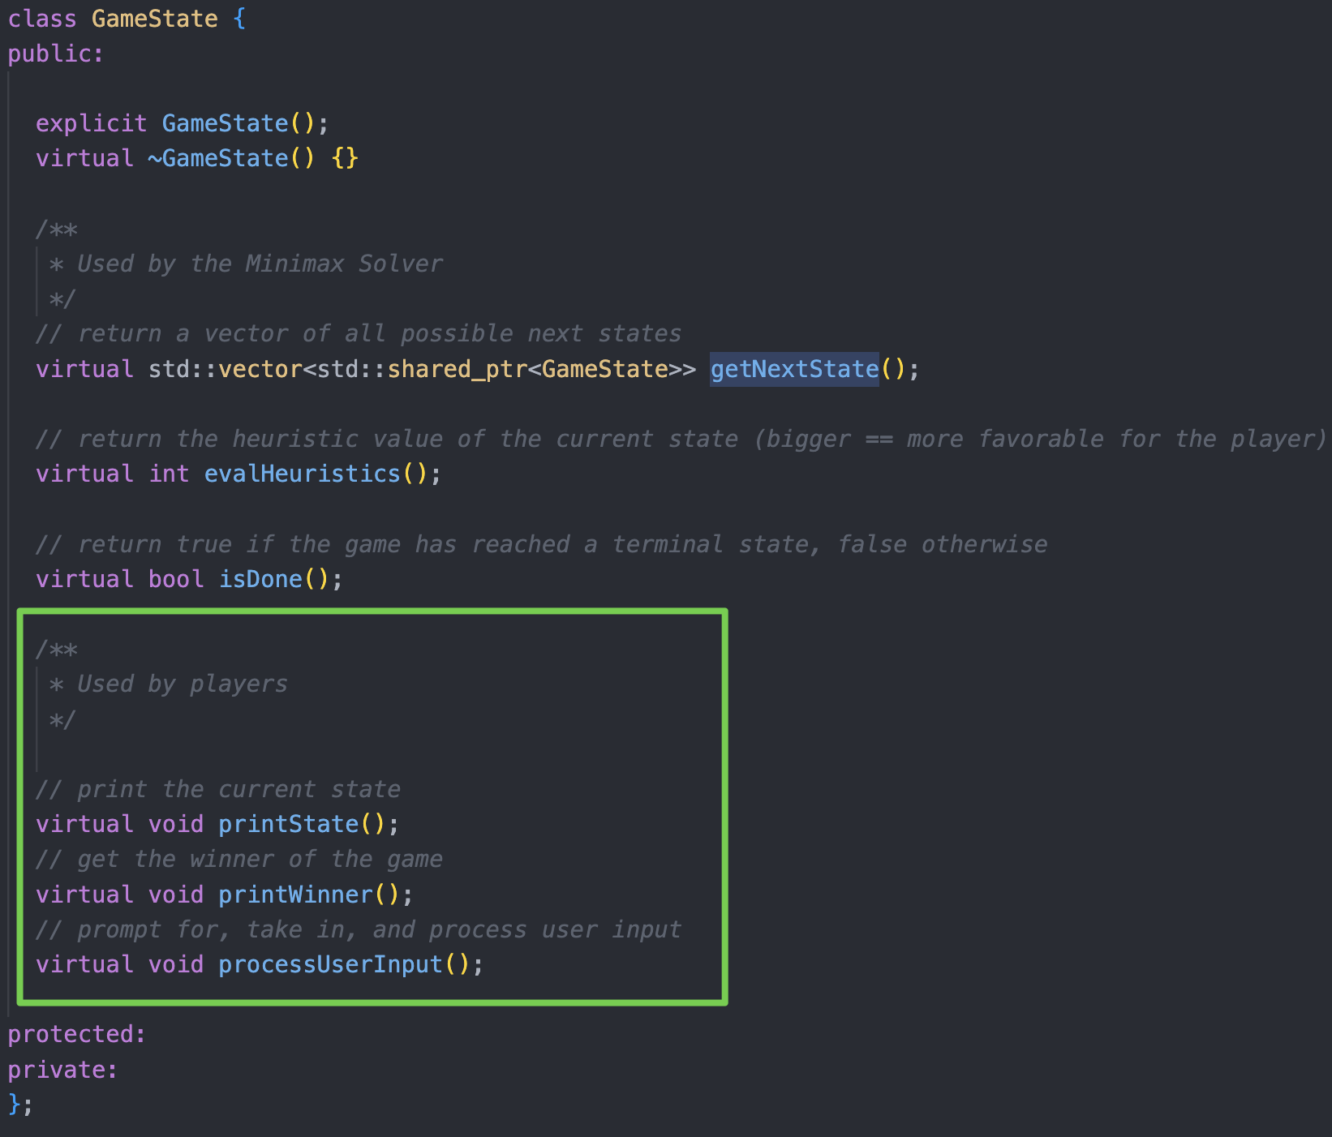
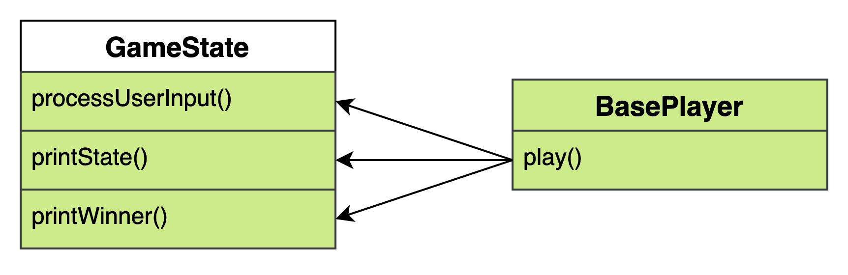
GameState & Player
Composed of a series of virtual functions that are called by the minimax algorithm and the players

Slide 24
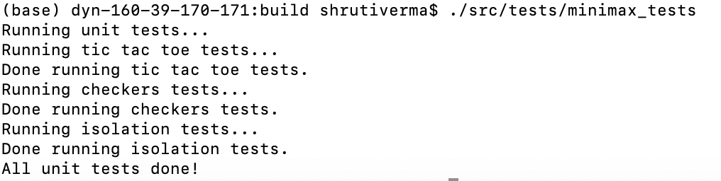
Other Folders
src/core/games_exe
Main executables for individual games: tic-tac-toe, Isolation, checkers
src/core/tests
Unit tests which check the Tic-tac-toe, Isolation, and Checkers implementations
Performance tests + measurements

Slide 25
Deeper Look into Generic Function
Notes:
=> show snippets of the different functions (evalHeuristics, getNextMove, etc.) for each of the games

Slide 26
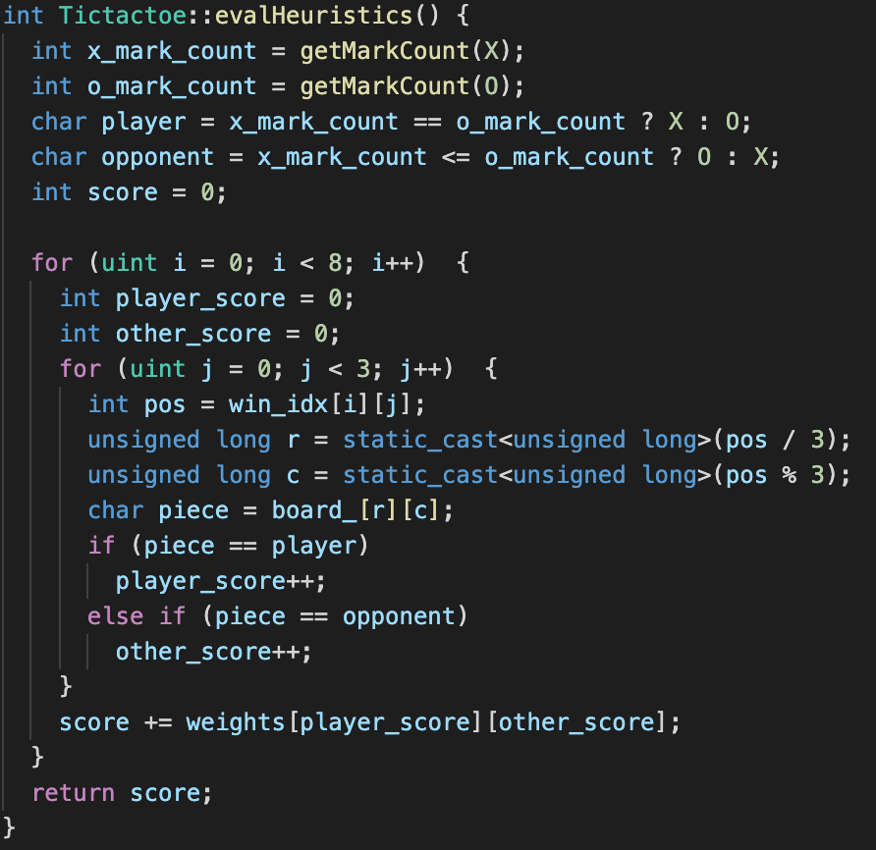
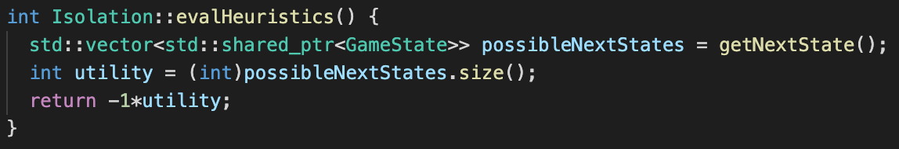
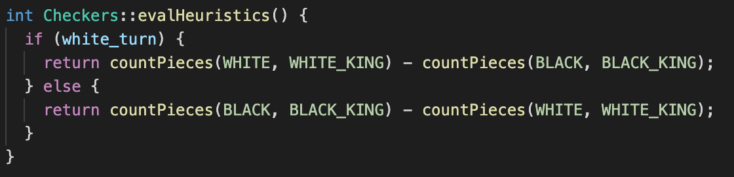
evalHeuristics()

Slide 27
getNextState()
X | 2 | X
 | 1 | X
 |  | X
X | O | O
O | X | X
X |  | O
X’s Turn
X | 2 | X
1 |  | X
 |  | X
1’s Turn
X | O | O
O | X | X
 |  | O
1 | 2 | X
 |  | X
 |  | X
X | O | O
O | X | X
 | X | O
X | 2 | X
X |  | X
1 |  | X
Tic-Tac-Toe
Isolation

Slide 28
Demo

Slide 29
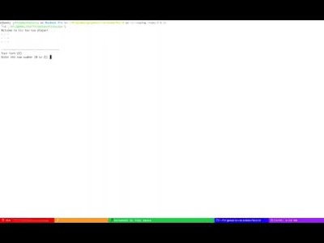
TicTacToe
https://youtu.be/zttWIFOICSA

Slide 30
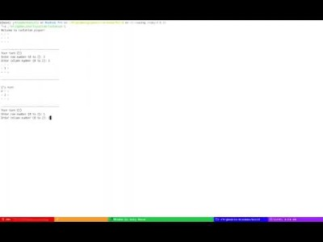
Isolation
https://youtu.be/gR7jdpYckG4

Slide 31
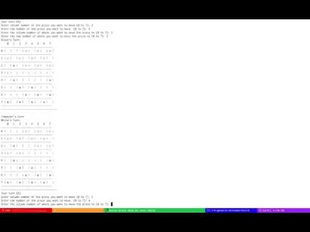
Checkers
https://youtu.be/oaZIC0iFw8g

Slide 32
Performance Tests
Notes:
=> show wo alpha beta pruning, with alpha beta pruning, and concurrent non-alpha beta pruning at different tree depths for each of the games

Slide 33
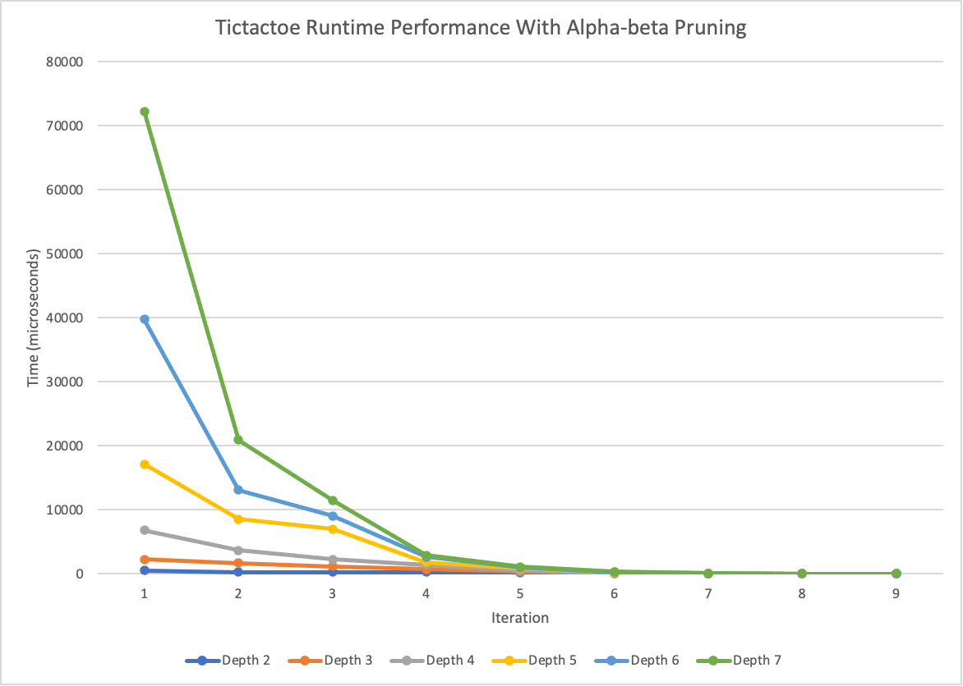
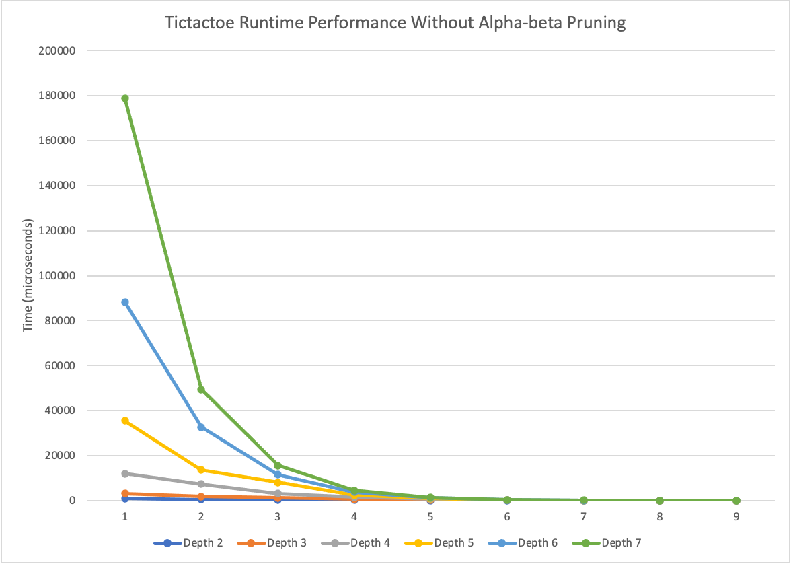
Performance: Tic tac toe
How long does it take to run evaluate()?
Parameters: max depth, iteration #

Slide 34
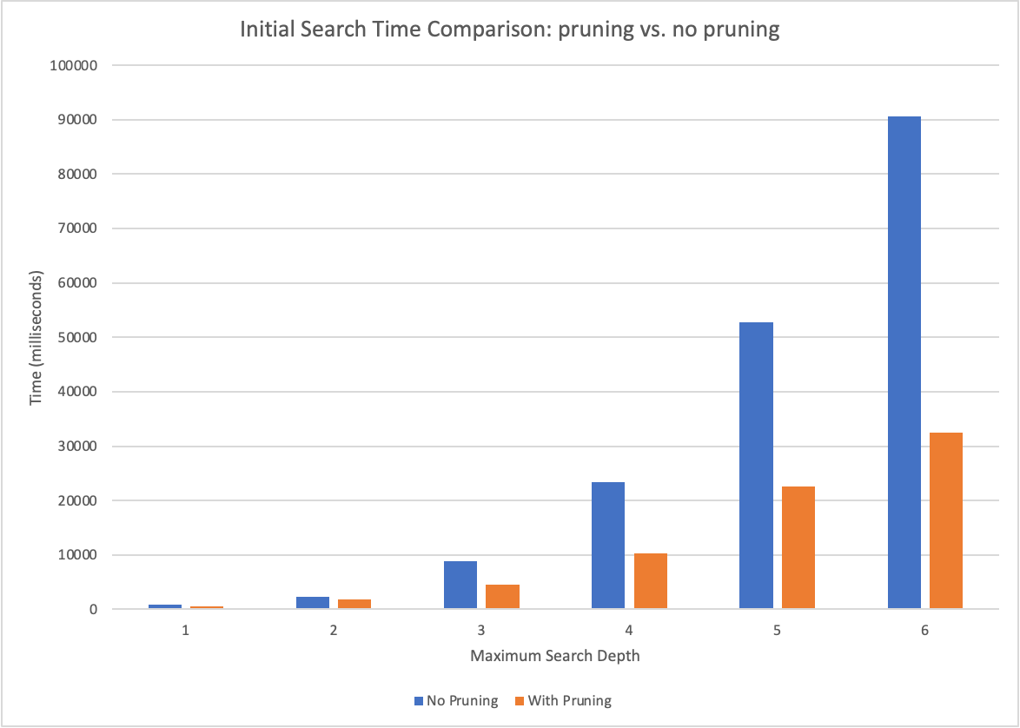
Effectiveness of α-β Pruning
Speed up of 2+ times!!

Slide 35
Future Directions
Notes:
=> show wo alpha beta pruning, with alpha beta pruning, and concurrent non-alpha beta pruning at different tree depths for each of the games

Slide 36
Potential Next Steps
In our project thus far, we leveraged various quintessential C++ features, such as the resource acquisition is initialization RAII principle (i.e. shared_ptr), abstract & concrete classes, virtual functions, inheritance, etc.
In the future, we would like to incorporate newer, C++ 20 features. Currently, clang does not fully support C++ 20. Later, when this changes, we hope to incorporate the following into our library:
Modules: export the minimax solver as modules
Parallelism: support parallel evaluation of the minimax algorithm for better performance

Slide 37
Acknowledgements
Notes:
=> show wo alpha beta pruning, with alpha beta pruning, and concurrent non-alpha beta pruning at different tree depths for each of the games

Slide 38

A BIG THANK YOU TO…
Professor Bjarne Stroustrup
For a series of fantastic lectures over the course of this semester, which gave us the knowledge + confidence needed to tackle this project, as well as for advising us on this project itself
Design Using C++ TAs: Ivy Basseches and Navjot Singh
For supporting us throughout the semester!

Slide 39
Any Questions?

